Slide 1


Social Buzz Analysis

Slide 2


Today's agenda
Project recap
Problem
The Analytics team
Process
Insights
Summary

Slide 3

Social Buzz is a fast growing technology unicorn
That need to adapt quickly to it’s global scale
Accenture has begin a three month POC focusing on these tasks:
An audit of social buzz’s big data practice
Recommendation of a successful IPO
Analysis to find social buzz’s Top 5 most popular categories of content
Project Recap

Slide 4

Problem
Over 100000 posts per day
36,500,000 pieces of content per year
But how to capitalize on it when there is so much?

Slide 5



The Analytics team

Slide 6
Data understanding
Process
1
Data cleaning
2
Data modeling
3
Data analysis
4
Uncover Insights
5

Slide 7

Insights
KPI’s Card : Category, Reactions in most popular category, Reactions Slicers : Category, Content type, Sentiment
Line chart : Monthly trends

Slide 8
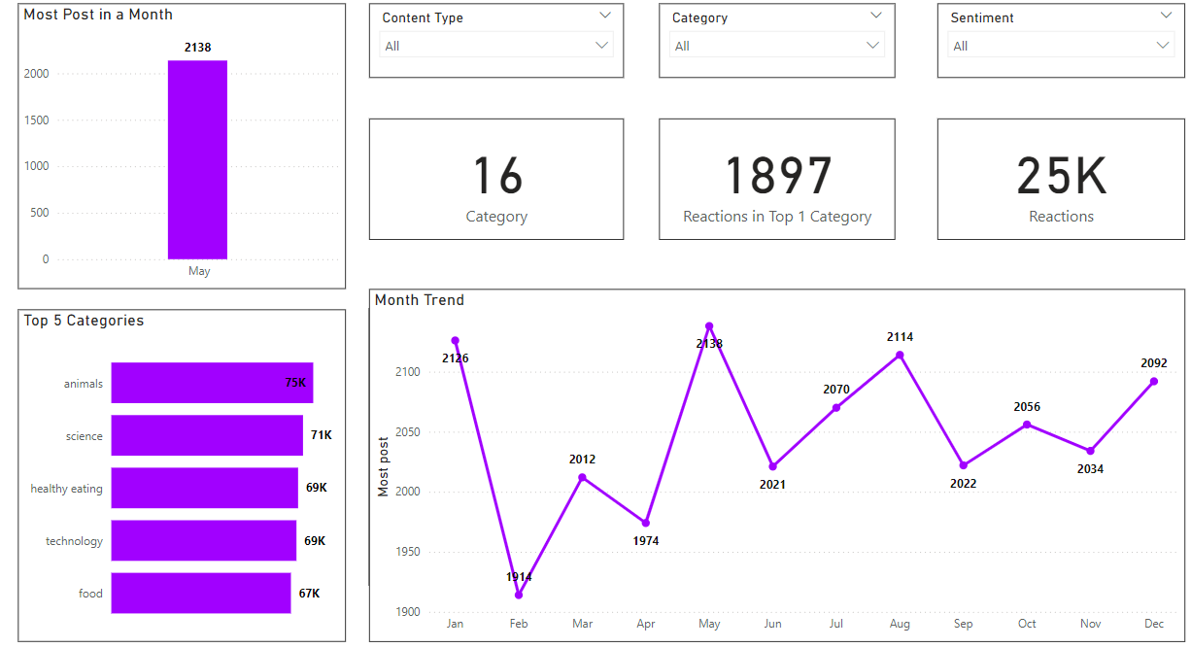

Slide 9

Top 5 content category are : animals, science, healthy eating, technology, food
There are 16 unique categories
There are 1897 reactions on most popular category
Month with most post is May
Summary

Slide 10
Thank you!
ANY QUESTIONS?

